Slide 1




EARTH 2.0
A journey to inspire, innovate and discover.

Slide 2
TABLE OF CONTENTS
01
02
03
04
INTRODUCTION
PROBLEM
SOLUTIONS
CONCLUSION

Slide 3
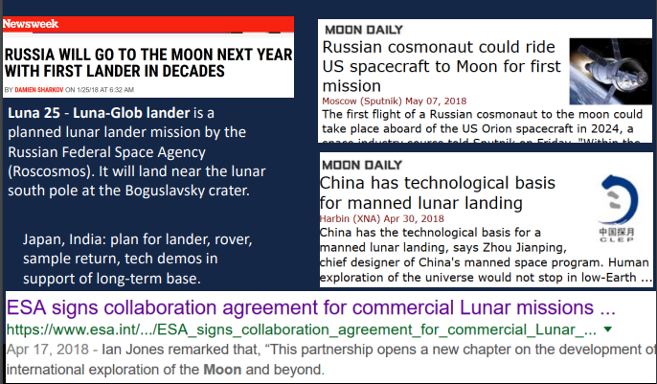

Headlines

Slide 4
Is life possible on the moon ?

Slide 5
Problem
In order to carry on with the Artemis mission, we targeted the south pole of the moon as a first destination, with advanced technologies aim to explore the moon's resources to be a step closer of the chance of living on the moon.

Slide 6
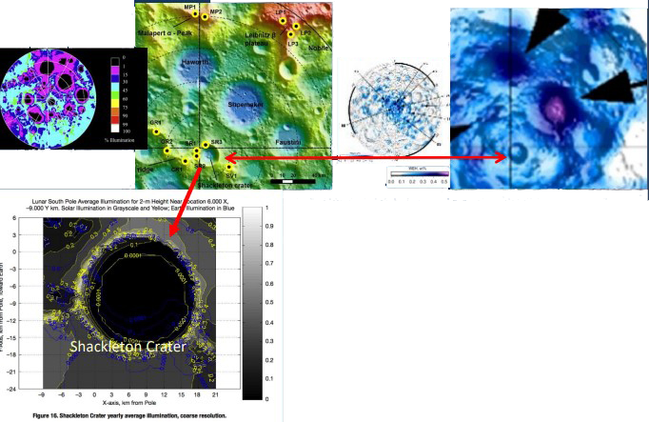
Detailed Characterization of Shackleton Crater
Maps of Sunshine
Maps of Water
WEH - Water Equivalent Hydrogen
Lunar South Pole has regions of sunlight and regions with water resources next to each other The rim of the Shackleton Crater is illuminated most of the time; the floor of the crater is permanently shaded, and there is indication of water in the icy regolith.

Slide 7
Solutions

Slide 8



ENERGY
OXYGEN
WATER

Slide 9
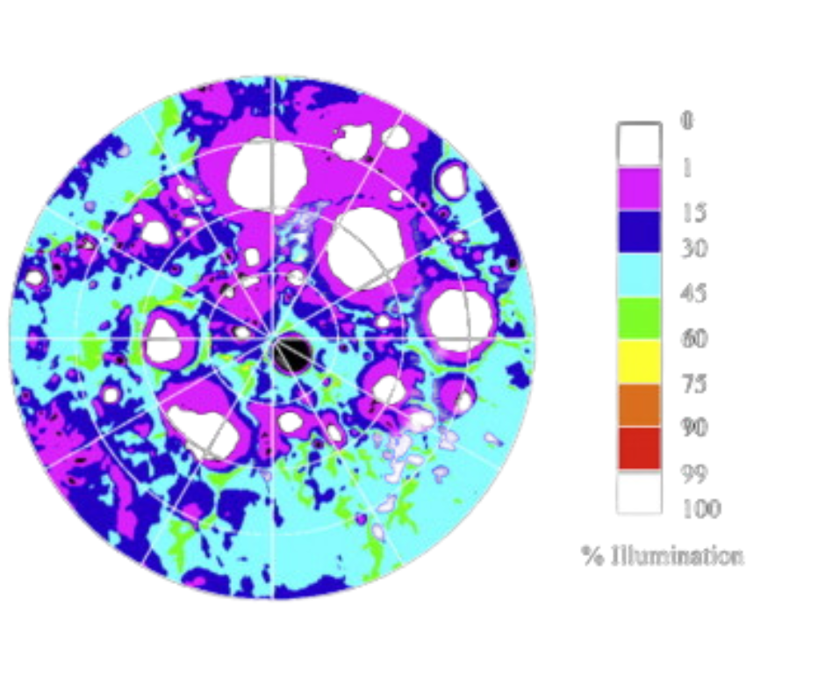
ENERGY
Create power infrastructure at south pole of Moon using system of strategically placed solar reflectors
– Several locations in south pole region
receive sunlight over 80% of the year
– Multiple coordinated reflectors could
redirect sunlight to area(s) of interest to give 100% of the year
– Reflector system could provide power to
multiple regions simultaneously

Slide 10
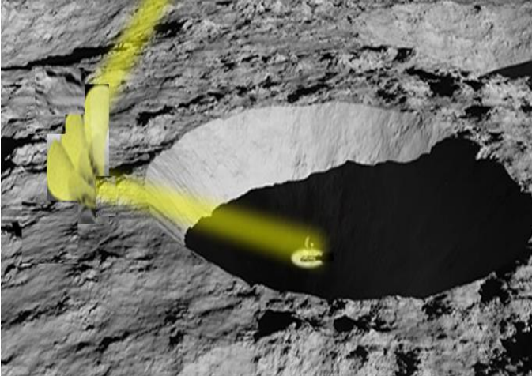
NIAC Study Objective: Determine feasibility of using reflectors to provide continuous, year-round access to sunlight to a target area near Shackleton Crater
– Identify optimal reflector placement locations
– Size power infrastructure according to ISRU mission requirements
– Evaluate structural designs and deployment mechanisms

Slide 11
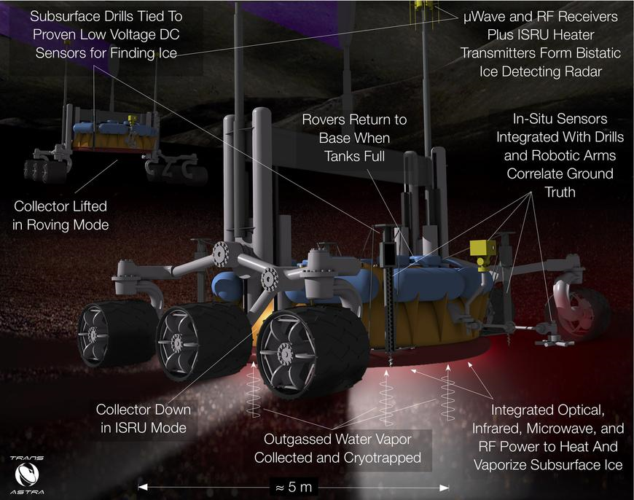
WATER
Detecting ice at lunar surface via low votlage sensors
Microwave, RF receivers and heat transmitters
The "water extraction rover" is proposed as a lunar water collection technology that includes heating methods based on fixed or mobile domes used with subsurface microwave heating and a method in which frozen regolith is placed in vessels for heating and extraction.
Rovers return to base when tanks full
Correlating ground truth via in-situ sensors integrated with drills.
Collecter lifted in Roving Mode
Collecter down in in-situ resource utilization mode
Heating (microwave) and vaporizing subsurface ice.
Collecting and Cryotrapping water vapor

Slide 12
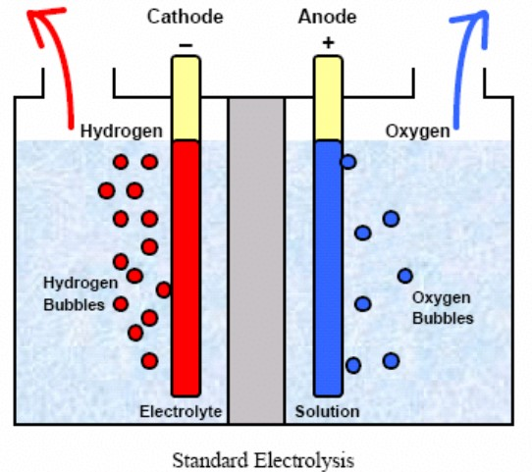
OXYGEN
A new study, shows that it is possible to produce hydrogen (for fuel) and oxygen (for life) from water The best way to do this would be by splitting water (H2O) into its constituents: hydrogen and oxygen. This is possible using a process known as electrolysis, which involves running a current through a water sample containing some soluble electrolyte. This breaks down the water into oxygen and hydrogen, which are released separately at the two electrodes.
Nature Communications
Notes:
Method of Making Oxygen from Water in Zero Gravity Raises Hope for Long-Distance Space Travel One of the main challenges with long-distance space flight is transporting enough oxygen for astronauts to breathe and enough fuel to power complex electronics. Sadly, there’s only little oxygen available in space and the great distances make it hard to do quick refills.

Slide 13
Conclusion
The exploration of the moon’s resources has led us to conclude that all the solutions are directly related (energy leading to water than to oxygen).
By providing vital key elements we will be able to build a greenhouse to ensure another principal element ‘’food ’’ for a permanent lunar life (the discovery of potato seeds sprouting on the lunar surface

Slide 14
THANK YOU FOR YOUR ATTENTION

